Slide 1
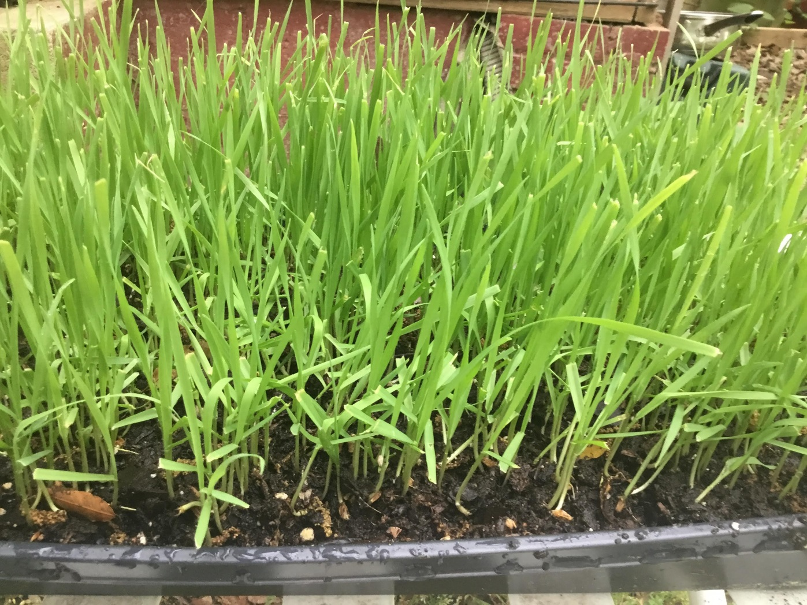
DIY Microgreens Grab N Go! Tween Program

Slide 2
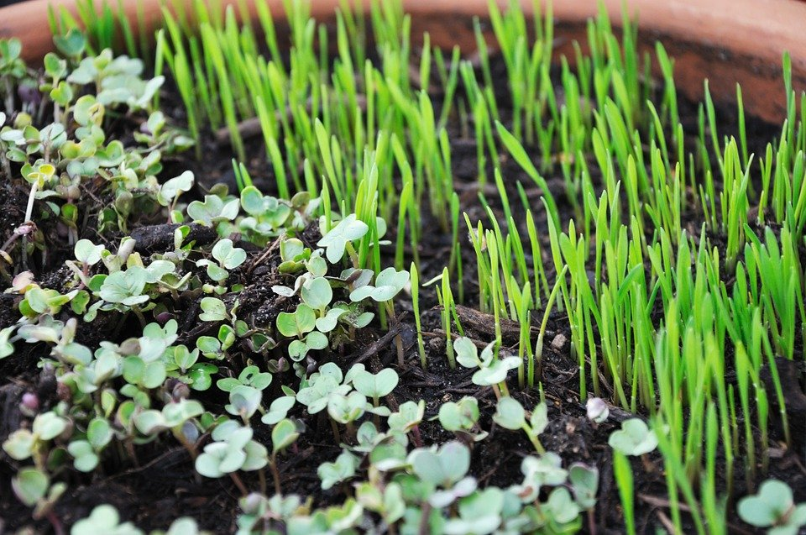
What are Microgreens?!
Microgreens are power packed superfoods that can be grown in 2 weeks or less.
Micro-greens got their name from the fact that they are the first growth of the seed, so it’s the plant in its “micro” form!
Microgreens are the first sprouted seedlings that come up from the soil, they are usually ready to eat in one to three weeks once the first leaves (cotyledons) have developed.

Slide 3
Benefit of Mung/Moong Bean Microgreens English –Mung, Sanskrit- Moong
Nutrients contained in Mung Beans:
Folate (B9), Manganese, Magnesium, Vitamin B1, Phosphorus, Iron, Copper, Potassium, Zinc, Vitamins B2, B3, B5, B6 and selenium
“The microgreens were four to forty fold more concentrated with nutrients than their mature counterparts,” says researcher Qin Wang, PhD, assistant professor at the University of Maryland in College Park. “When we first got the results we had to rush to double and triple check them.”

Slide 4
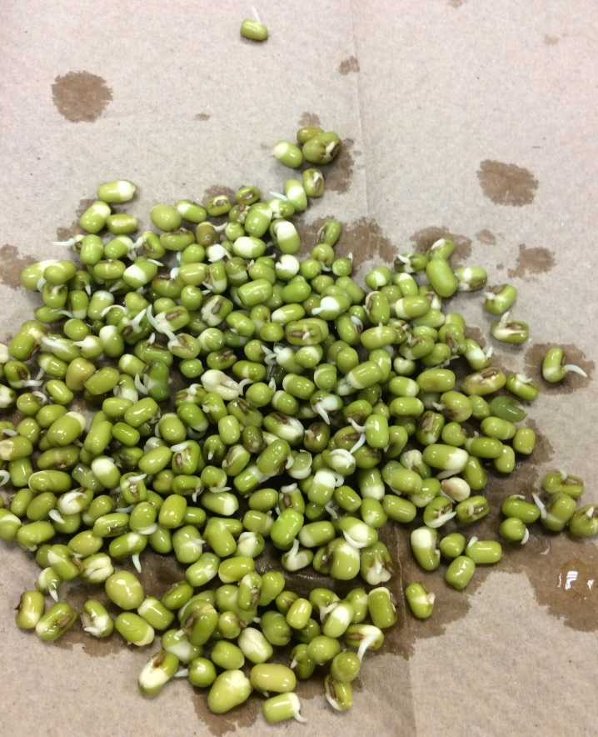
How to Grow Mung Bean Microgreens
Soak Your Mung Beans
The amount you soak depends on the size container you will use to plant your microgreens. You want to soak enough to cover the entire surface of your tray/container.
Put the mung beans in a cup and fill it so the water is about 2 inches above the beans. Because of their size, they will soak up a nice amount of water.
Let the beans soak for 24 hours; once done drain the water, and let the mung beans sit in a bowl until you are ready to plant. (if you are not going to plant that same day the mung beans will be ok overnight in the bowl on the counter or in the refrigerator, they will actually begin to sprout.

Slide 5
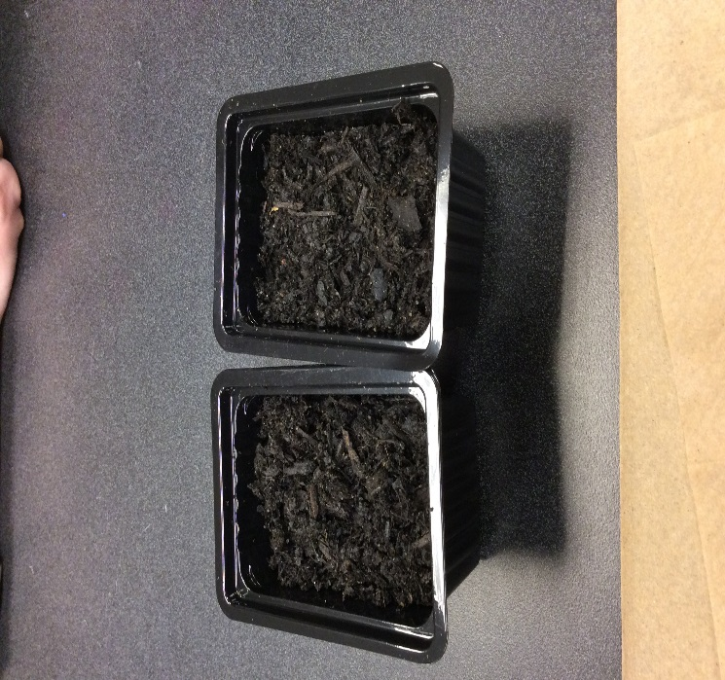
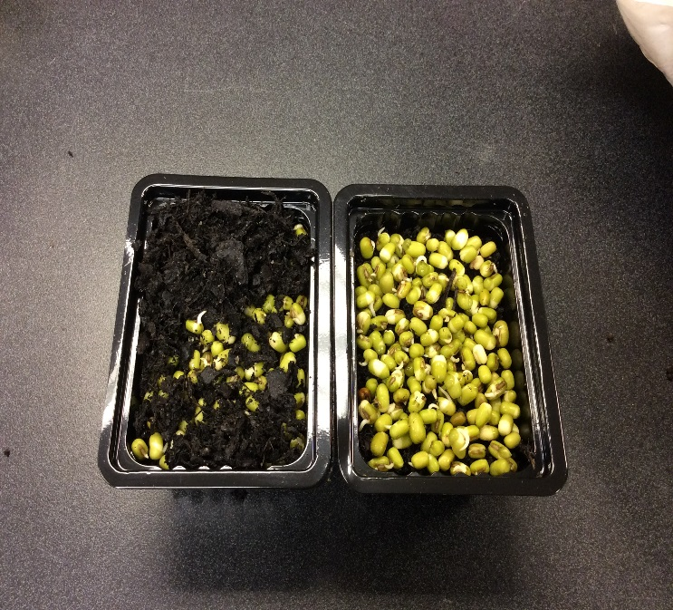
Plant Mung Beans in Trays
-Using potting soil or garden soil fill the container or tray, from 1 to 1 ½ inches from the top. You will need to leave room to put soil on top of the mung beans.
- Fill the length of the tray with mung beans, they should cover the entire surface. It is also ok if they somewhat overlap a little, this allows for a nice plush harvest that will give you a great yield.

Slide 6
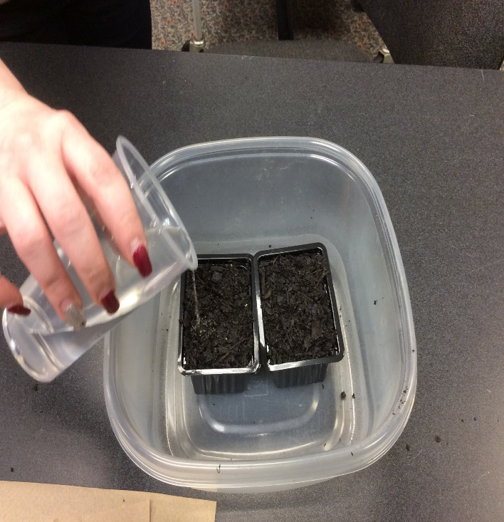
Watering and Taking Care of your Mung Beans You are Almost Done, Just a Few More Steps!
Once you have covered your seeds, (you should have about an inch of soil covering the seeds.) Water the lightly.
DO NOT pour water heavily over the seeds, this can saturate them to much. Gently sprinkle water evenly across the entire surface making sure the soil gets moist.
REMEMBER: the seeds are already soaked and germinating so they won’t need to be really watered good for about two days.
One good way to determine if your mung beans need watering is by checking the soil, if you pick a little up and it is powder or doesn’t hold together definitely water it. If the soil is still moist you can wait another day.

Slide 7
Thanks for Participating! We have a lot of great tween programs coming each month!
Our April Program:
Make Your Own Hypertufa Pots!
Contact Us
website: www.andersoncountylibrary.org
call Youth Services at 864-260-4500 x158
childrens@andersonlibrary.org

